Slide 1

MIGRATION
LOGO DE LA CONSULTORA
A PROJECT ABOUT HOW MOVING PEOPLE INFLUENCE COUNTRIES.

Slide 2





THE TEAM
MYSLER, ALAN
ZAPATA, BELÉN
RODRIGUEZ, LUCAS
BALL, EUGENIA
PINI, MAURO
Data Scientist
Data Analyst
Data Engineer
Data Engineer
Functional Analyst

Slide 3

MIGRATION
The phenomena of migration and human mobility are an innate characteristic of the human being, of an ancient nature and have affected almost without exception all societies in the world. Migration is a complex topic, and as such it can be distorted to alarming degrees by misinformation and politicization.
The understanding of this phenomena from the perspective that Data Science provides us will be the characteristic criterion of our approach, without falling into ideological biases or opinions of a personal nature.

Slide 4

OUR CONTEXT
Migratory flows (MF) refer to the number of migrants arriving or leaving an area over a specified period of time. These zones can be countries, regions, cities or continents.
Characteristics of MF vary depending on places, time, country's policies, demographic, socio-political, environmental and economic aspects, among others.
Our team will explore in detail, increasing our understanding and reserving the prerogative to modify the focus of the report as our knowledge and expertise on the phenomenon under study deepens and increases.

Slide 5

OUR GOALS
Use different data sources to explore, understand and determine which features affect MF the most.
Analyze MF by zones to broadly understand the scale, direction and frequency of movements.
Create a global database that brings together different sources with an automatized update system.
Manufacture a detailed report of the respective conclusions and insights.
Develop machine learning models to respond to different inquiries.
Design a technological interface for the average user.

Slide 6

REACHINGS
By February 28th we will achieve:
Access to private repository with the entire project related files.
+ 5 KPI's with their respective explanation, usage information and interpretation.
Trained machine learning model, with access to the code and step-by-step instructions.
Interactive Dashboard with metrics, statistics and KPIs.
Detailed report of the whole project.
Report meeting with the entire team.

Slide 7
KEY PERFORMANCE INDICATORS
Increase in annual net migration (x amount)
Increase in annual net migration (by %)
Increased Desired Conditions
Decrease in Unwanted Conditions
Increase in skilled immigrants

Slide 8



KEY PERFORMANCE INDICATORS
Increase in annual net migration (x amount)
Increase in annual net migration (by %)
Increase in skilled immigrants

Slide 9


KEY PERFORMANCE INDICATORS
Increased Desired Conditions
Decrease in Unwanted Conditions

Slide 10
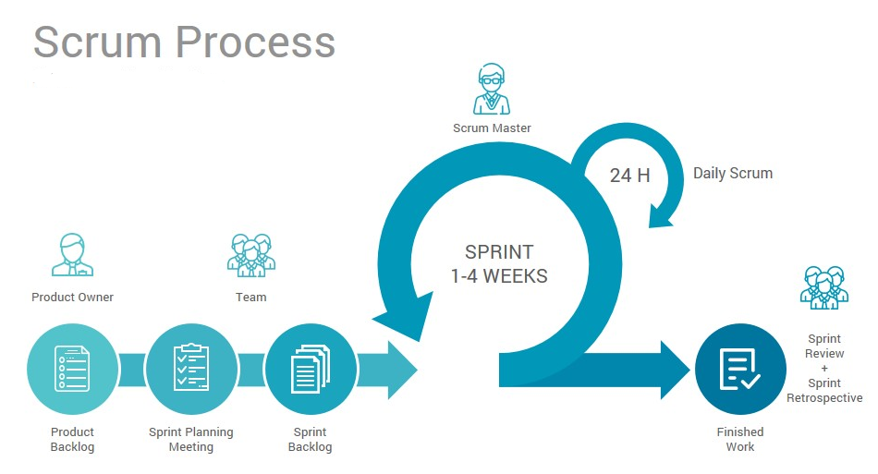
METHODOLOGY
Our basic working process consists of daily meetings to make sure everything is being done in time, and to provide help where and when needed.
Two mandatory meetings, one in the morning so set the tasks that need to be done that day, and the evening meeting to check what has been done and what needs to be pushed for the next day.

Slide 11
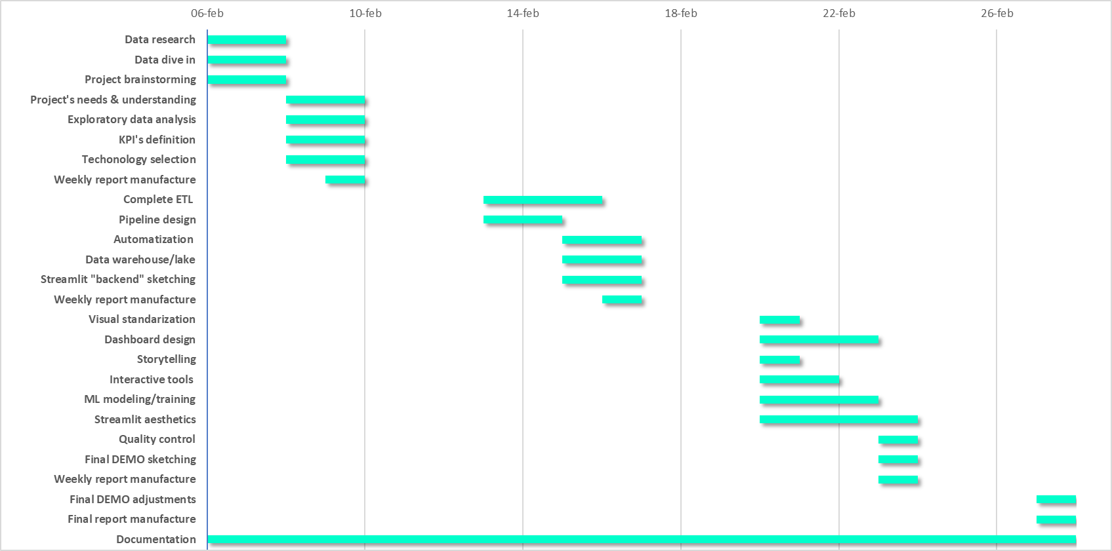
GANTT CHART
16 hs
16 hs
16 hs
16 hs
16 hs
16 hs
16 hs
8 hs
48 hs
16 hs
32 hs
8 hs
32 hs
8 hs
8 hs
48 hs
16 hs
32 hs
52 hs
64 hs
16 hs
16 hs
16 hs
8 hs
8 hs
44 hs

Slide 12








TECHNOLOGIES

Slide 13
THANK YOU.
Are there any questions?

